Slide 1
ESA Commitment Evaluation
2013 - 2020
Notes:
Add note to this slide

Slide 2
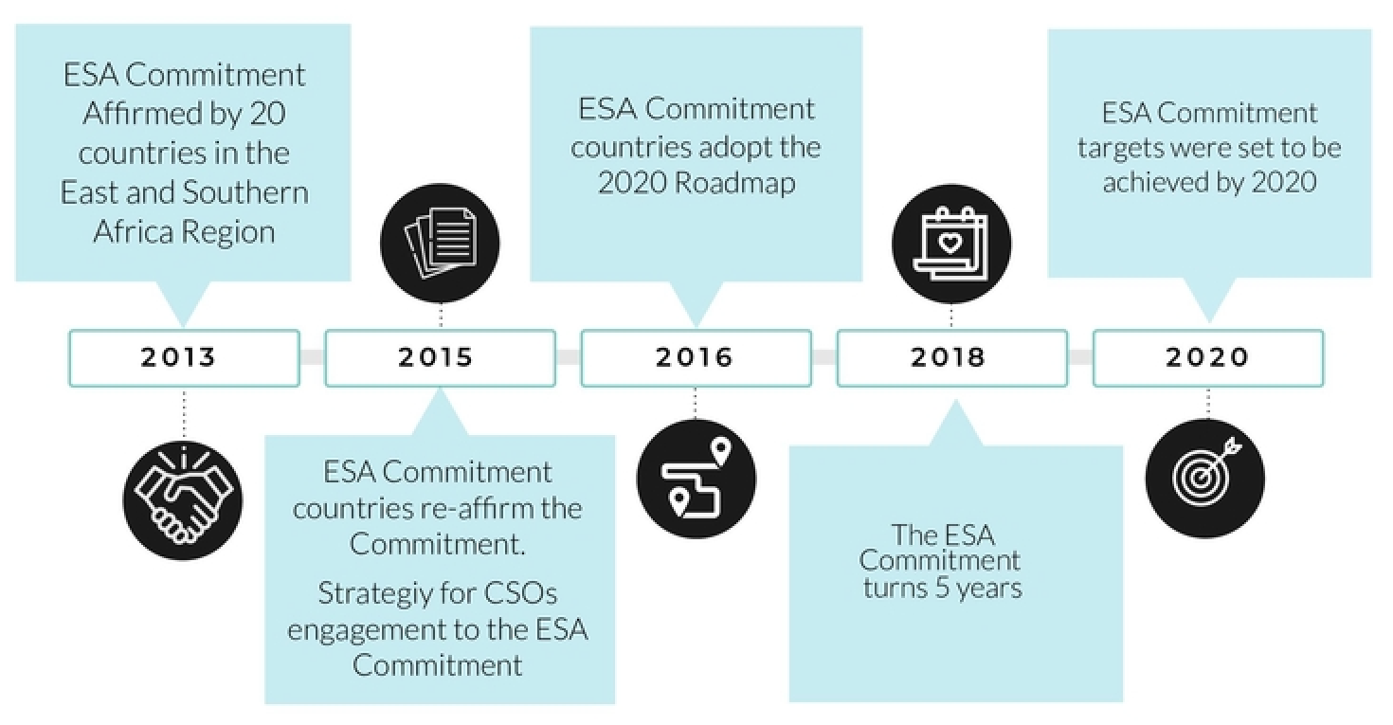
Evaluation of the ESA Commitment
Notes:
Add note to this slide

Slide 3
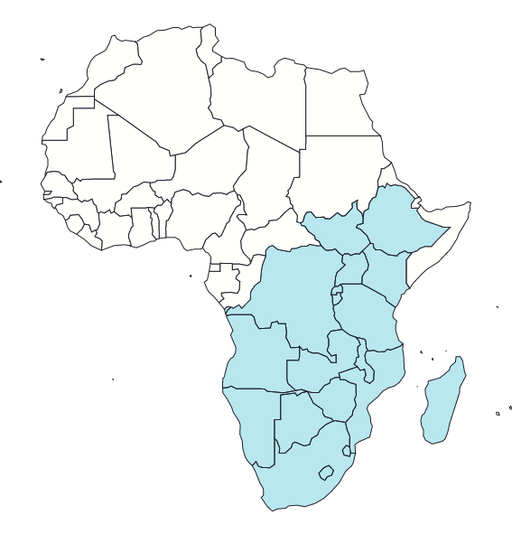
ESA Commitment Countries
Angola, Burundi, DR Congo, Zambia, Zimbabwe, Botswana, Namibia, Swaziland, Lesotho, South Africa, Ethiopia, South Sudan, Kenya, Uganda, Rwanda, Seychelles, Tanzania, Malawi, Mauritius, Madagascar, Mozambique
Notes:
Add note to this slide

Slide 4
ESA Commitment Targets
2015 targets
2020 targets
A good quality CSE curriculum framework is in place and being implemented in each of the 20 countries.
Pre- and in-service SRH and CSE training for teachers, health and social workers in place and being implemented in 20 countries.
By the end of 2015, decrease by 50% the number of adolescents and young people who do not have access to equitable, accessible, acceptable, appropriate and effective youth-friendly SRH services, including HIV.
Consolidate recent and hard-won gains in the reduction of HIV prevalence in ESA and push towards eliminating all new HIV infections among adolescents and young people aged 10 - 24.
Increase to 95% the number of adolescents and young people aged 10 - 24 who demonstrate comprehensive HIV prevention knowledge levels.
Reduce early and unintended pregnancies among young people by 75%
Eliminate gender-based violence and child marriage.
Increase the number of schools and teachers training institutions that provide CSE to 75%.
Notes:
Add note to this slide

Slide 5
Evaluation Aim
Assess progress made in achieving the 2015 and 2020 targets of the ESA Commitment Regional Accountability Framework (RAF)
Assess processes -e.g. efficiency of the multi-sectoral mechanisms; coordinating mechanisms
Evaluation Approach and Methods
DAC Criteria (Effectiveness, Relevance & Coherence, Efficiency, Sustainability) + Emerging issues
Mixed methods
Stakeholder Mapping & Document Review (Desk study)
Regional online survey (all 21 countries)
Online regional in-depth interviews (KIIs)
10 in-depth country case studies (including selected KIIs and FGDs when possible with beneficiaries)
Triangulation and Analysis
Co-creation of recommendations
Notes:
Add note to this slide

Slide 6
Key
Findings
Notes:
Add note to this slide

Slide 7
Relevance and Coherence
ESA Commitment influence on the development of national and regional ASRHR laws, policies, and strategies
Country level:
ESA commitment increased political will and engagement on A&Y SRHR
Countries with legal and policy frameworks in place used the ESA Commitment to advance implementation by developing national strategies and implementing guidelines on SRHR
ESA Commitment facilitated creation of advocacy windows for CSOs to engage government
Despite political will, challenges remain in harmonisation of laws to align to national commitments (esp. related to the age of consent to sex, marriage and access to SRH services such as family planning commodities)
ESA Commitment targets do not detail progress towards effective and supportive implementation of the law for adolescent and youth.
Notes:
Add note to this slide

Slide 8
Relevance and Coherence
ESA Commitment influence on the development of national and regional ASRHR laws, policies, and strategies
Regional level:
ESA commitment raised awareness within the Regional Economic Communities including the EAC and SADC of fundamental importance of improving A&Y SRH in the sub-regional as an economic priority;
Relevance to the needs of Adolescents and Young People:
ESA Commitment contributed to an acceleration of legal and policy developments and strengthening of ASRHR;
UN sponsors have largely driven the topical areas that received the most attention.
Notes:
Add note to this slide

Slide 9
Effectiveness - Evaluation Criteria
Existence and implementation of a good quality CSE curriculum framework;
Establishment and implementation of pre- and in- service CSE and SRH training for teachers and health and social workers;
Adolescents and young people’s equitable, accessible, acceptable, appropriate and effective access to youth friendly SRH services, including HIV related services;
Elimination of new HIV infections among adolescents and young people;
Demonstrated comprehensive HIV prevention knowledge levels among adolescents and young people;
Reduction of early and unintended pregnancies among young people;
Elimination of gender-based violence;
Elimination of child marriage;
Provision of CSE in schools and teacher-training institutions;
Developing and enforcing an enabling environment.
Notes:
Add note to this slide

Slide 10
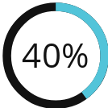
ESA Evaluation Findings [1]
Target 1: A good quality CSE curriculum framework is in place and being implemented in each of the 21 countries
Target 2: Pre- and in-service CSE and SRH training for teachers and health and social workers are established and being implemented in all 21 countries
15
countries were offering life skills-based HIV and sexuality education in at least
The percentage of schools with teachers who received training, and taught lessons, in life-skills based on HIV and sexuality education in the previous academic year, was
40% of primary schools by 2018.
17
countries had a CSE Strategy for in-or out-of school youths
for primary schools
for secondary schools
Notes:
Add note to this slide

Slide 11
ESA Evaluation Findings [2]
Target 3: Decrease by 50% the number of adolescents and young people who do not have access to youth-friendly SRH services, including HIV related services that are equitable, accessible, acceptable, appropriate, and effective
Target 4: Eliminate all new HIV infections among adolescents and young people aged 10-24
By 2018, all 21 countries reported providing pre-service and/or in-service training programmes on the delivery of the adolescent/youth-friendly services.
There were 30% less new infections, from
366,900
to
258,192
The ESA Commitment enabled the achievement of
provision of pre-service and/or in-service training programmes on the delivery of adolescent/youth-friendly services
among adolescents and young people in ESA Region between 2013 and 2019
Notes:
Add note to this slide

Slide 12
ESA Evaluation Findings [3]
Target 5: Increase to 95% the number of adolescents and young people aged 10-24 who demonstrate comprehensive HIV prevention knowledge levels
Target 6: Reduce early and unintended pregnancies among young people by 75%
16
By 2018, 40% of adolescents and young people demonstrate comprehensive knowledge of HIV prevention , up from 36% in 2015.
countries (up from 5 in 2013 and 9 in 2015) had a policy for learner pregnancy and re-admission by 2018.
Notes:
Add note to this slide

Slide 13
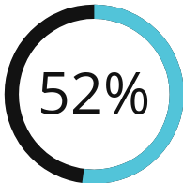
ESA Evaluation Findings [4]
Target 7: Eliminate gender-based violence
in 2015, 52% of women aged 15-24 yrs believed that wife-beating is justified for at least one of the five reasons specified.
Governments in the ESA Commitment made significant strides in creating an enabling environment to address school-related gender-based violence
11 countries introduced new SRGBV guidelines,
+7 maintained their existing SRGBV guidelines.
Notes:
Add note to this slide

Slide 14
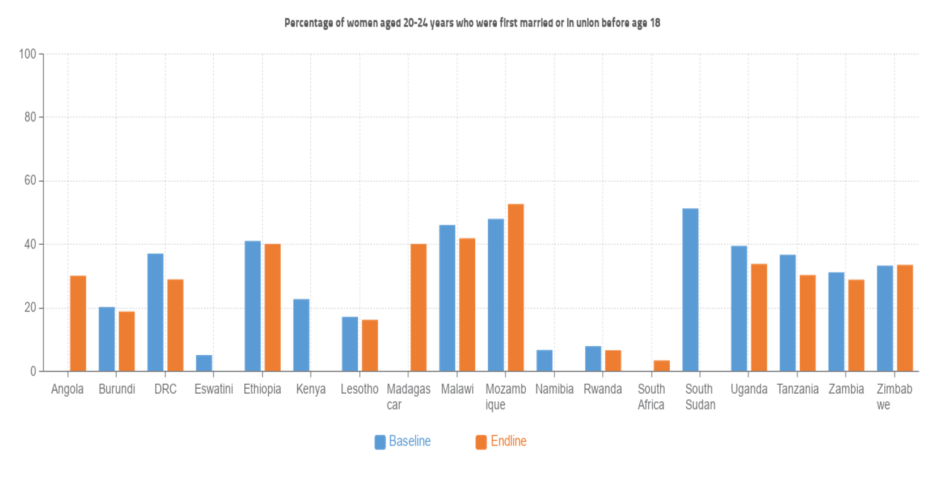
ESA Evaluation Findings [5]
Target 8: Eliminate child marriage
16
countries (from 5 in 2013 and 12 in 2015) had programmes and policies to mitigate child marriage
Notes:
Add note to this slide

Slide 15
Efficiency
In-country coordination:
Gaps reported in the lack of strength and responsiveness of M&E systems in some countries (i.e. resulted in delayed or absent reporting on certain indicators)
Resourcing:
Reported increase in resourcing for priorities in the ESA Commitment, however scale of increase was difficult to quantify as allocations were not earmarked or clearly tracked in country budgets
Funding sources - reported donor-dependency in-country, and where domestic resources were available, weak budget-tracking
UN agencies resourcing - UNESCO, UNAIDS & UNFPA pulled resources at regional and country level to jointly fund prioritised activities
Notes:
Add note to this slide

Slide 16
Efficiency
Regional coordination:
Coordination at regional level was reported to have resulted in effective reporting on the commitment from education ministries at SADC level, the successful launch of two regional programmes and the sustained political prioritisation of ESA Commitment targets in all countries;
Most coordination successes at regional level attributed to leadership of influential individuals who facilitated key political processes and drove engagement of some stakeholder clusters like CSOs
Both RECs reported having inadequate human resources and financial support to fulfil their coordination role for the Commitment
Gap most significant for EAC impeding ability of RECs to effectively support their Member States
Notes:
Add note to this slide

Slide 17
Sustainability
Levels of national ownership of ESA Commitment by governments are mixed across the region;
Significant policy and legal changes achieved across most areas but dissemination, implementation or enforcement remains limited at subnational levels, among service providers and local decision makers
Across the region, the tendency is that out-of-school CSE remains implemented as small-scale projects through civil society actors or UN partners, leading to coverage gaps and risks of fragmentation
Insufficient data collection related to YFHS in some countries prevents monitoring, evaluation and an evidence-based assessment of coverage
Notes:
Add note to this slide

Slide 18
Sustainability
The COVID-19 pandemic highlighted sustainability gaps of youth programming as domestic funding was re-directed for mitigation
Range of strategies put in place to improve multisectoral and multi-stakeholder collaborations (perceived as an improvement in the governance of youth health issues)
ESA Commitment fostered exchange on policy and structural changes, and less on interventions - discussion on scalability is lacking
Overall, limited space created within ESA Commitment coordination mechanisms for the dissemination of best practices.
Notes:
Add note to this slide

Slide 19
Key Recommendations [1]
Effectiveness
Relevance and Coherence
Use and test innovation with strong documentation of best practices
Ensure further disaggregation of data
Conduct a systematic review of implementation modalities for CSE at the country level
Create a robust engagement mechanism for young people’s participation
Balance support and engagement of RECs
Pitch the ESA Commitment at a higher political level, and with renewed narratives
Notes:
Add note to this slide

Slide 20
Key Recommendations [2]
Efficiency
Sustainability
Strengthen ESA Commitment coordination and accountability
Improve the quality of teaching and learning materials
Improve domestic, regional, and global resource mobilisation
Strengthen referral linkages between schools and health facilities
Develop and report on a composite youth indicator for youth well-being
Fast-track review, harmonisation, and implementation of laws and policies
Notes:
Add note to this slide

Slide 21
Next
Steps
Notes:
Add note to this slide

Slide 22
ESA Commitment Roadmap April - December 2021
In 2013, 20 ESA countries affirmed the ESA Ministerial Commitment on CSE and youth friendly services with targets until 2020. The ESA Commitment will be extended to align with the 2030 Development Agenda and address the unfinished business.
APRIL
MAY
JUNE
EAC Ministers of Health meeting: 20th Sectoral Council Meeting for Health Ministers
Evaluation report: Evaluation report incorporating comments received from the TCG members to be shared by 23 April
Presentation to TCG: Presentation of the
evaluation report to all TCG Members
High-Level Group: The HLG reconstituted and invites sent
Issue Paper: Development of an Issue Paper for High Level commitment
SADC MOE Meeting: SADC Ministers of Education meeting
EAC MOE Meeting: EAC Ministers of Education meeting
Regional validation: A virtual validation by extended TCG
Asset folder: Asset folder and report shared with countries
JULY
AUGUST
SEPTEMBER
National validations: National validations and consultations on the evaluation’s findings
Regional consultation: Regional Consultation on ESA Commitment.
Drafting: Drafting exercise of the new ESA Commitment
OCTOBER
NOVEMBER
DECEMBER
EAC MOH Meeting: 21st Sectoral Council Meeting for Health Ministers – last week of October
SADC MOH Meeting: SADC Ministers of Health meeting
Signing of ESA Commitment: Signing event ICASA
Notes:
Add note to this slide

Slide 23
Thank
You
Notes:
Add note to this slide

